Slide 1
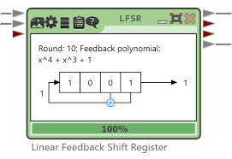
Week 1 Practical: CryptTool 2 Overview
CT5046

Slide 2
Overview
Caesar Cipher
Vigenère cipher
Bringing it all together
Post-sessional work

Slide 3
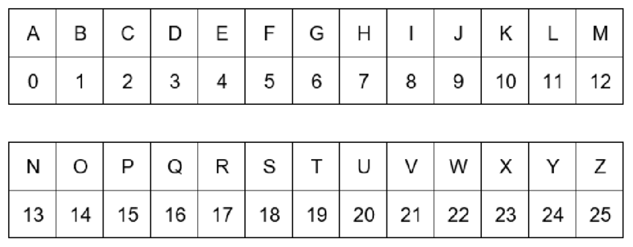
Alphabet index

Slide 4
Caeser Cipher

Slide 5
Caeser Cipher overview
Developed and used by Julius Caesar Substitution cipher
Encryption achieved through shifting each character by a
fixed amount
For each character (Cp) in a plaintext, each character is shifted using:
E(Cp) = (Cp + Shift)mod 26

Slide 6
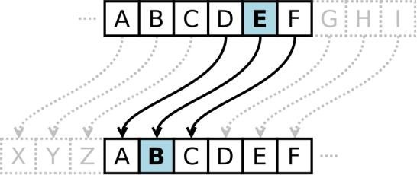
Character shifting

Slide 7
How a Caeser Cipher works
Imagine that we have the plaintext P: roses are red
Suppose we are going to encrypt P using Caesar cipher with Shift S = 3
The resulting ciphertext C then becomes: urvhvduhuhg

Slide 8
Visualising algorithms
One of the most useful tools for cryptography visualisation is CryptTool 2
A link on the moodle page will take you to the download of the software
Once installed, run the application

Slide 9
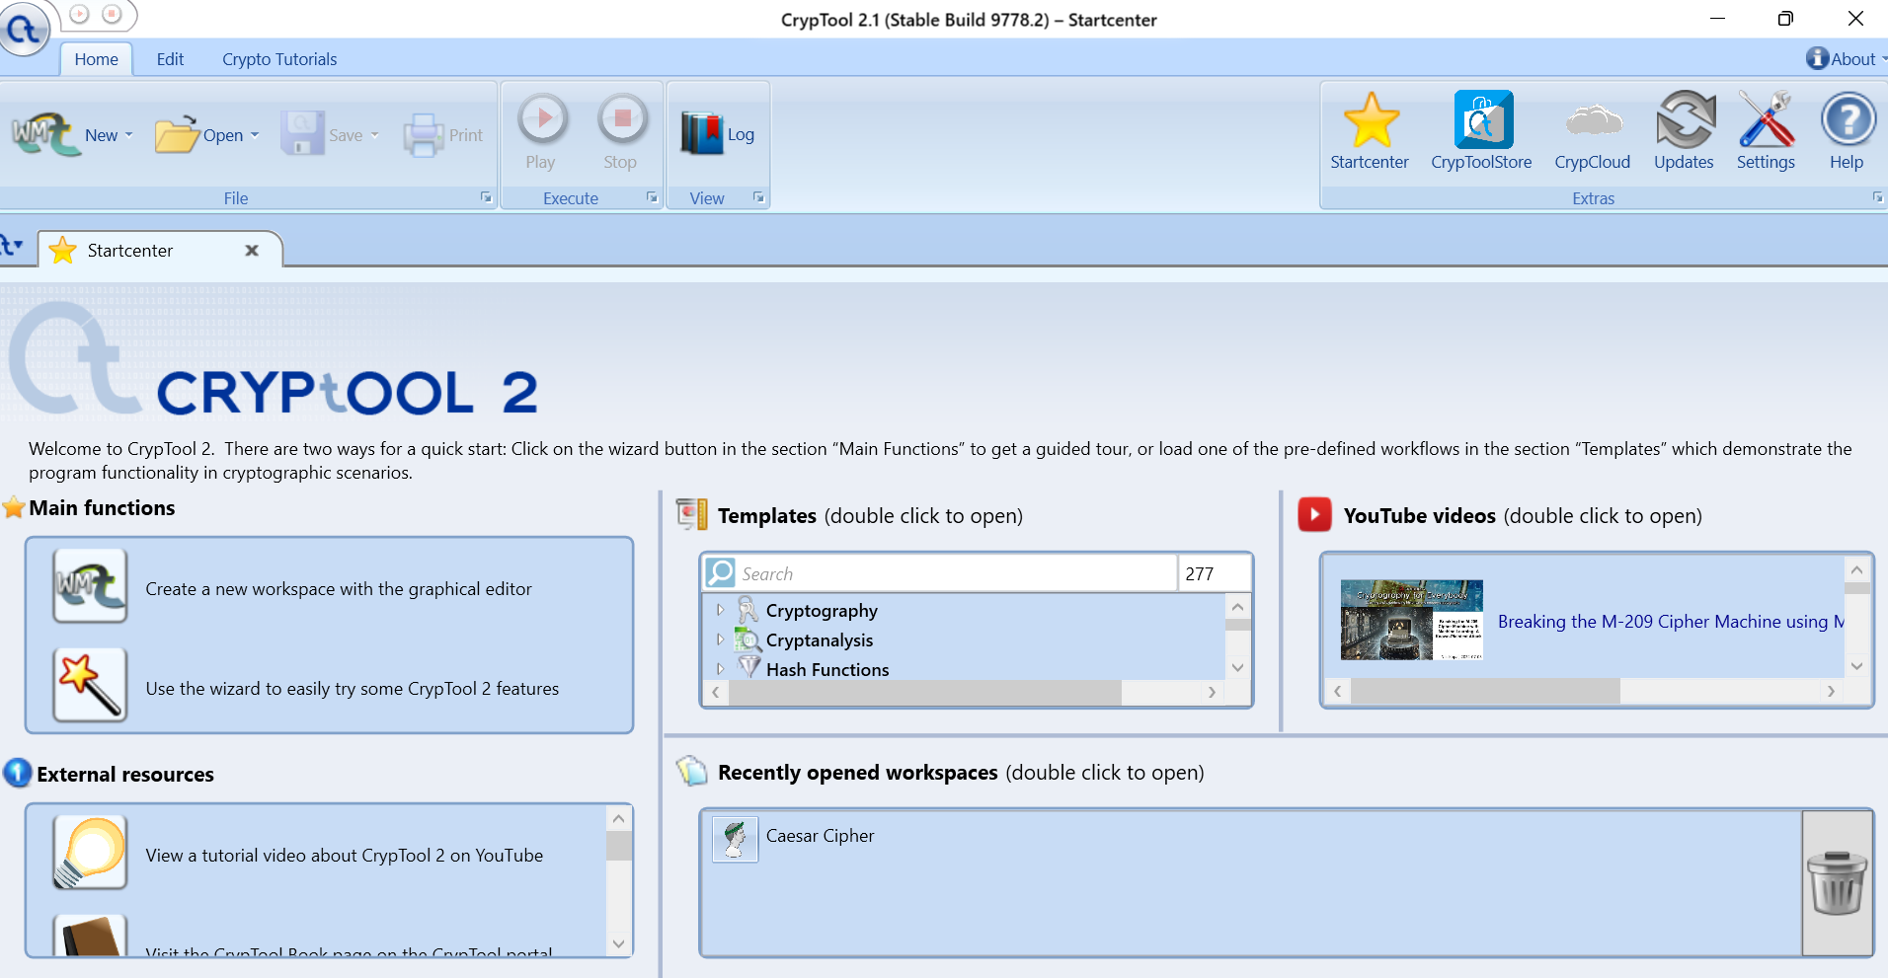
Main page

Slide 10
Caeser Cipher on CryptTool 2
From the CryptTool 2 startup menu, navigate to Templates and click Cryptography
Then click Classical and then select Caesar cipher
In the plaintext section of TextInput, type in: roses are red
Then in the Key as integer box, set it to 3
Finally click on the Play button to execute

Slide 11
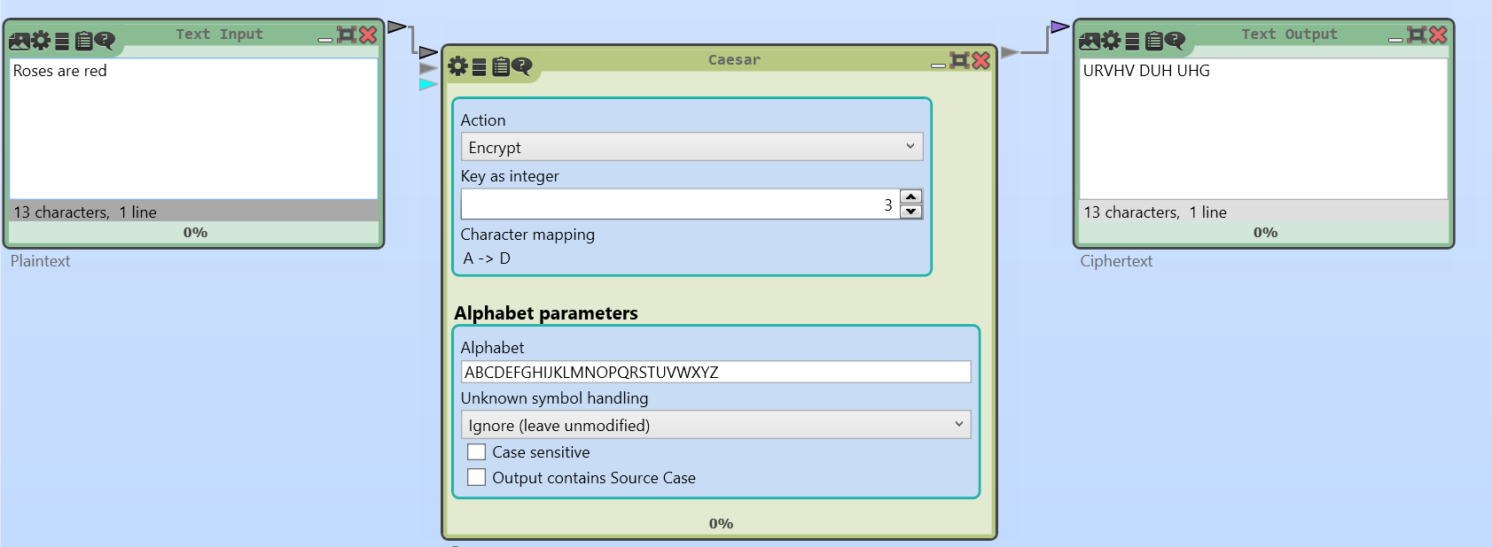
Caeser Cipher on CrypTool 2

Slide 12
Exercise
Imagine you have been given this plaintext P: Joe needs to go to the doughnut
Using Caesar cipher and a shift number of your choice (between 0 ∼ 25), encrypt P
Send the encrypted ciphertext C to the student next to you and ask them to decrypt it

Slide 13
Vigenère Cipher

Slide 14
Overview of Vigenère Cipher
Developed by Balise de Vigenère
Can be thought of as a modified version of the Caesar cipher Features the use of key rather than shifting characters around
Makes the use of frequency analysis more diﬀicult

Slide 15
Encryption and Decryption process
Given a plaintext P = {p1, p2, ..., pm}, and key K = {k1, k2, .., kn}
Ciphertext C = {c1, c2, ..., cm} is obtained using
ci = (pi + ki)mod 26
Decryption:
pi = (ci − ki)mod 26
Plaintext P: Roses are red
Key K: KING

Slide 16
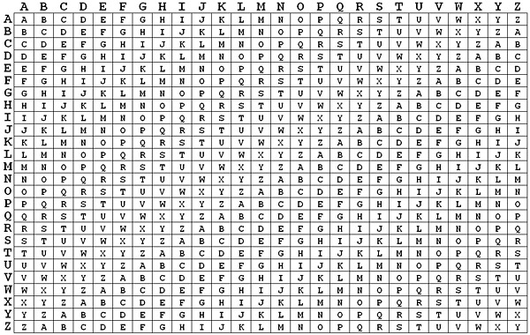
Reference Table

Slide 17
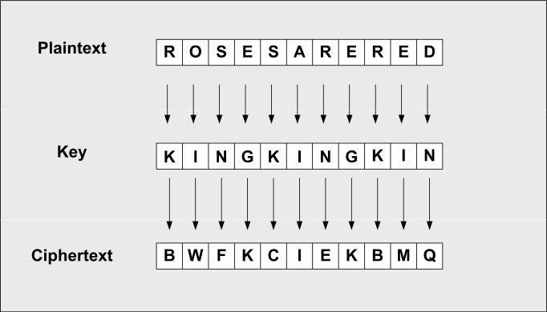
How it works

Slide 18
Vigenere Cipher on CryptTool 2
From the CryptTool 2 startup menu, click Cryptography
Then click Classical and then select Vigenère cipher cipher In the plaintext section of TextInput, type in: roses are red
Then in the Key box, type in: KING
Finally click on the Play button to execute

Slide 19
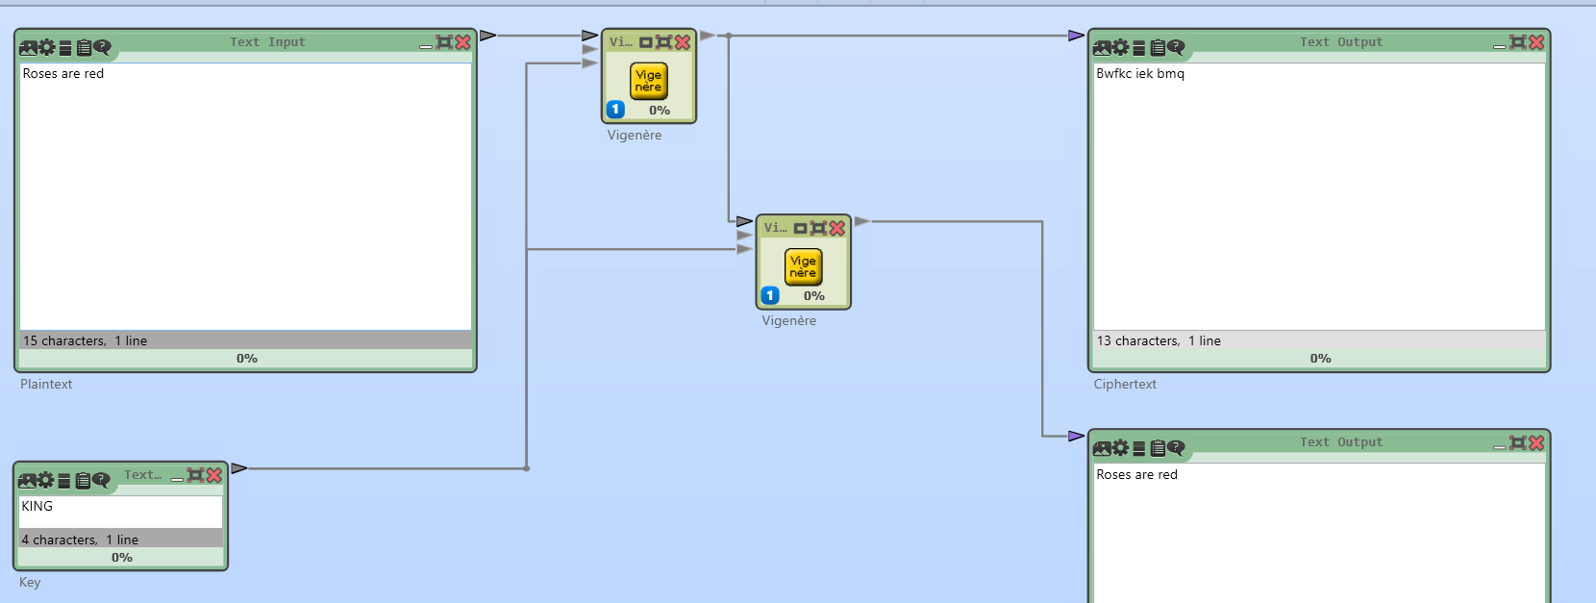
Vigenère cipher on CryptTool 2

Slide 20
Exercise
In groups or individually, create some phrases and encrypt them with the Caeser and Vigenère cipher
Swap with other individuals and encrypt each other’s
Challenge: Try encrypting a phrase using both ciphers then decrypt the ciphertext using CryptTool2

Slide 21
Recap
Today we looked at CryptTool 2
We looked at both Caesar and Vigenère ciphers
Next week: Number theory and other classical ciphers

Slide 22
Post-sessional work
Based on your understanding of the two ciphers which we looked at, write a critical report discussing how they can be cracked
You need to use both your understanding of the practical's as well as the post-sessional reading materials as starting points Upload your completed work to Moodle before next Friday

Slide 23
Q&A

